Slide 1
Data Mining Using Tableau
Churn Investigation
-Maseerah Muradabadi
-University of Missouri Kansas City

Slide 2

What is Churn Rate?
The percentage at which subscribers opt out of a service or leave the service

Slide 3

About the Dataset
A bank in Europe has its branches in 3 countries: France Spain and Germany
A total of 10,000 sample data collected at random
Data contains fields like Customer Id, Surname, Credit Score, Geography, Gender, Age, Tenure, Balance Num Of Products, Has Cr Card, Is Active Member, Estimated Salary, Exited

Slide 4


Data mining in Tableau- Insights

Slide 5
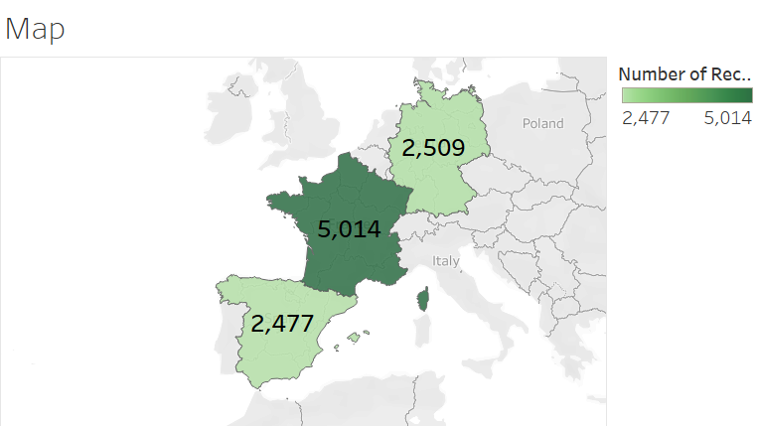

Slide 6
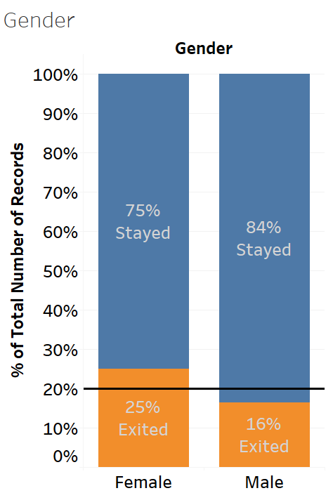
A reference line of 20% indicates the average exited rate
Female exit rate is greater than Male
The feature Gender does have an impact on churn rate/ exit rate for this bank

Slide 7
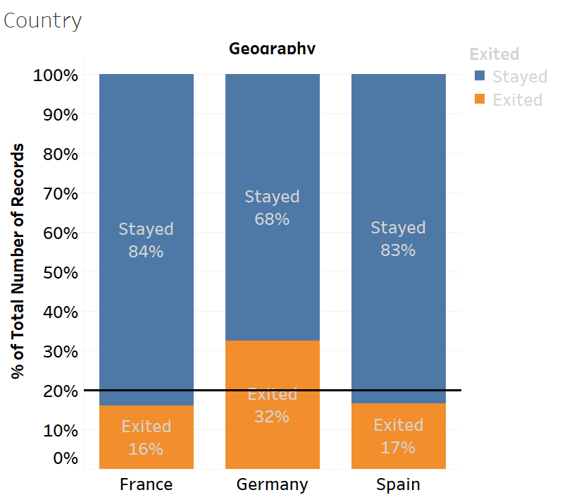
Country-wise exit rate split Germany with highest exit rate The feature ‘Country’ does have an impact on exit rates

Slide 8
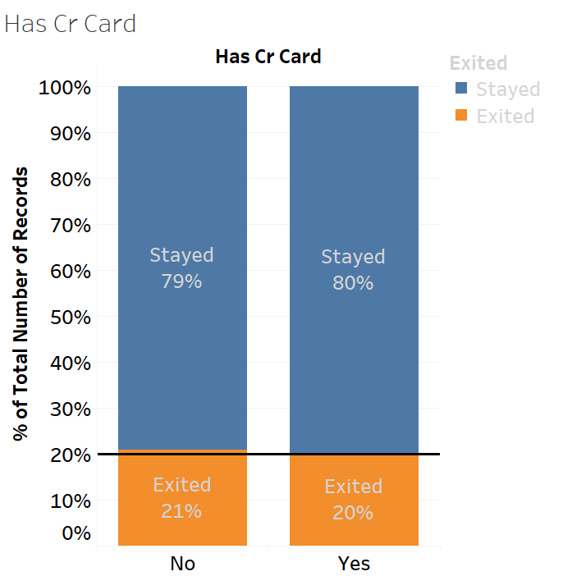
There is almost no difference(1%) whether a customer has a credit card or not
Therefore, the feature ‘Has Cr Card’ is not significant
We can also run a Chi-squared test to verify our claim, we get the same result

Slide 9
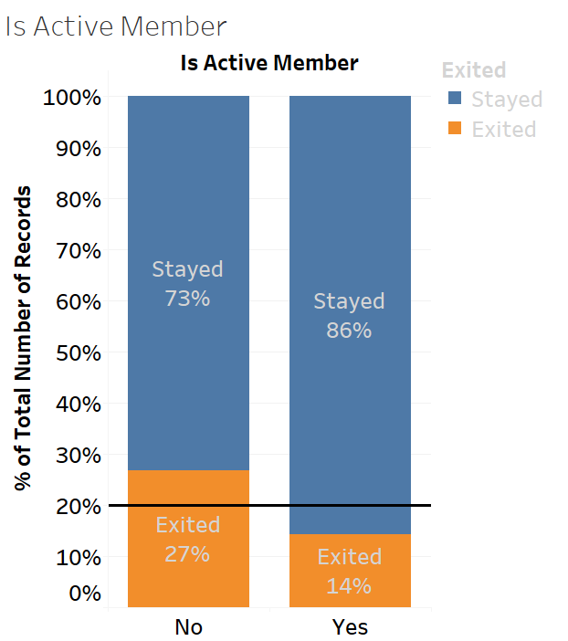
Observe that most customers exit the bank who have not been active members

Slide 10
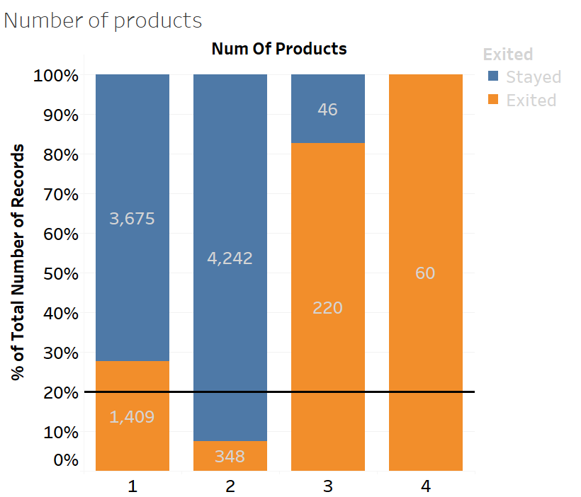
Errors in data collection
Given that the banks do provide 4 services, it looks like the data points collected for service 3 and 4 are too less to make a decision that all customers with 4 services exit the bank followed by 3
We can say that, we have insufficient data to provide analysis

Slide 11
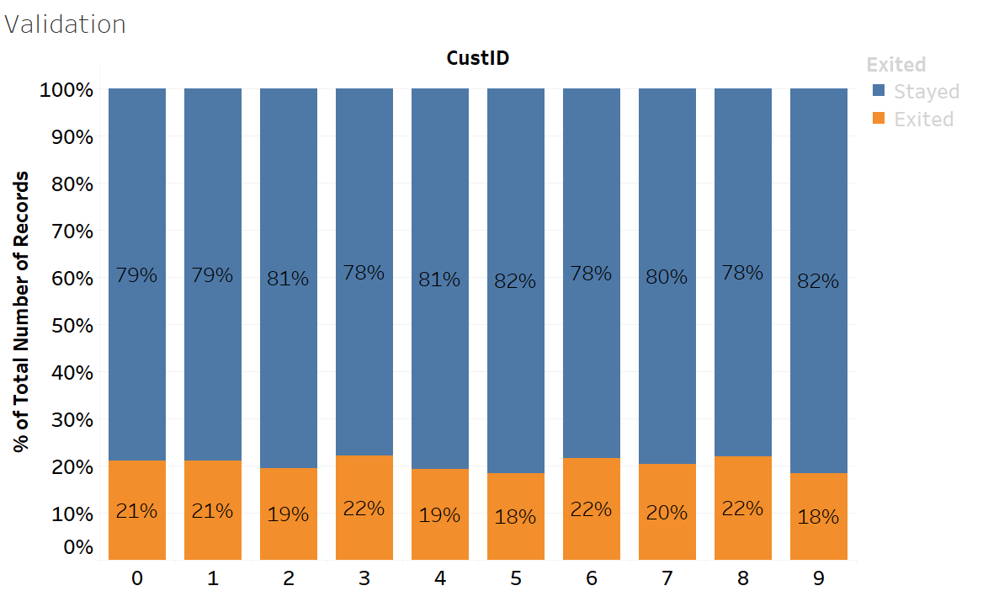
Unique ways of viewing churn data
- The last digits of customer id’s is taken and set against the Sum of total records to denote the churn rate across all last digit id’s
- Since the data shows that the exit rate is almost the same across all columns, we can say it is error free and consistent

Slide 12
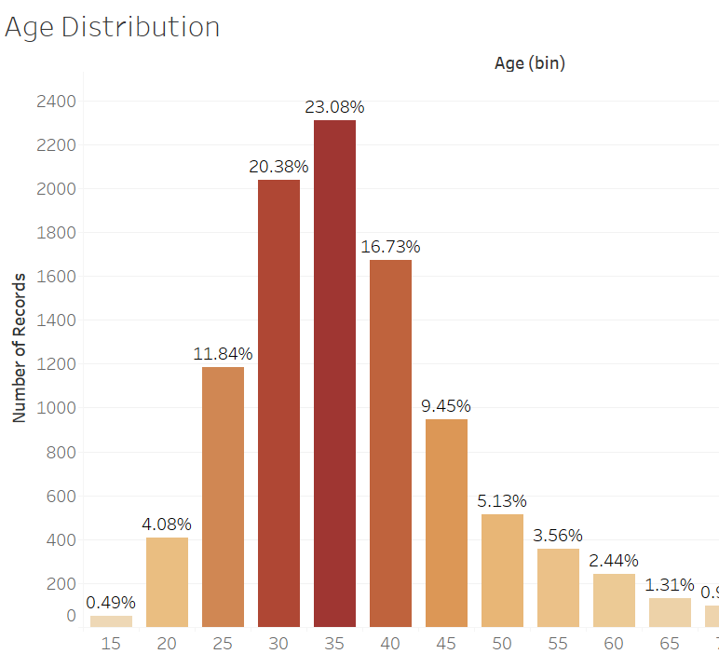
Business Insights
As a bank, we do want to look at this feature, in order to attract and engage our customers
By the Age distribution, we see that we have more customers from the range 25 to 44 years of age
We can use this insight to get attractive offers for this demographic

Slide 13
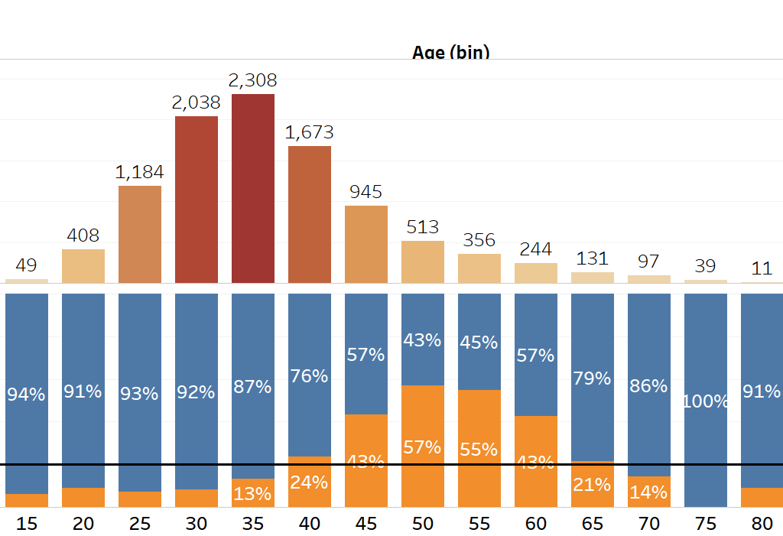
Understanding our Audience
As data analyst/scientist, it is always recommended to back our analysis on facts and figures
The distribution shows that we do have a good number of records that prove that there are more customers from the age 26 to 44 years
Another key point to observe is how the customer exit rate has increased from age 41 to 60, although we may need to look into this in detail, with more data to figure out why people of this age are exiting the bank

Slide 14

Thank you

